Slide 1




Week-4 (Discussion)
15th Aug, 2025
Computer Vision
Prof. Jayanta Mukhopadhyay
Professor
Computer Science and Engineering Department
IIT Kharagpur
Ayan Paul
PMRF Research Scholar
IIT Kharagpur

Slide 2
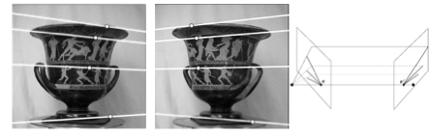
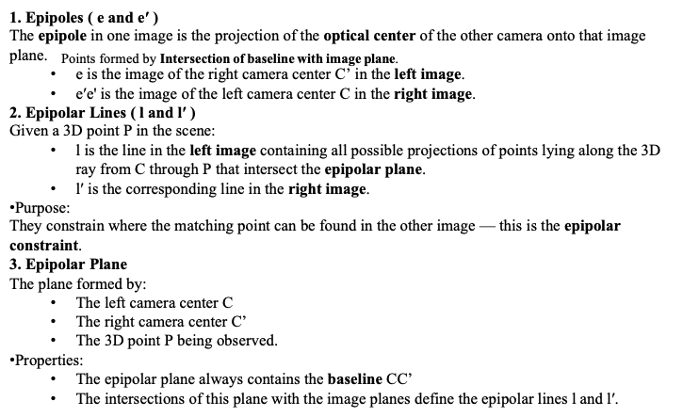
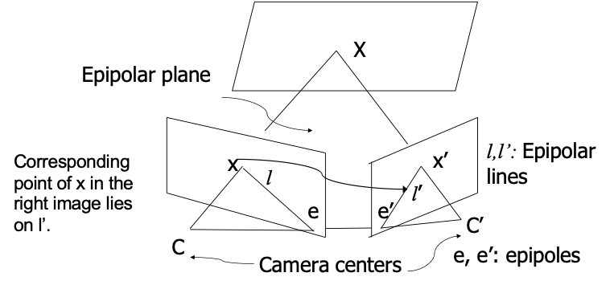
Stereo Geometry
In computer vision, stereo geometry refers to the study of the geometric relationships between two cameras that observe the same scene from different viewpoints.
The goal is to understand how the 3D structure of the scene relates to the 2D images captured by each camera, so that depth and 3D shape can be recovered.
Key ideas in stereo geometry
Imagine two cameras (left and right) separated by a fixed distance (called the baseline).
Each camera sees the same scene but from a slightly different perspective.
Stereo Set-up
Epipolar geometry

Slide 3
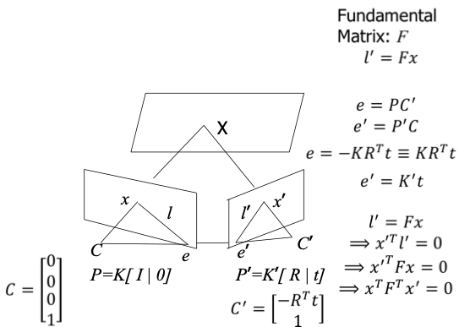
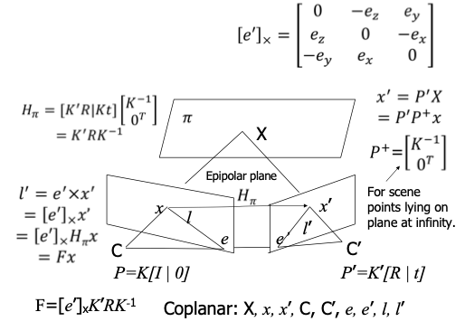
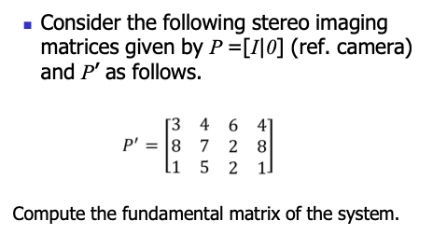
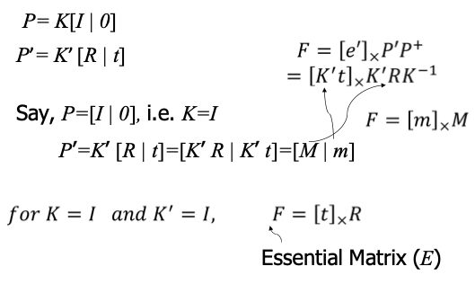
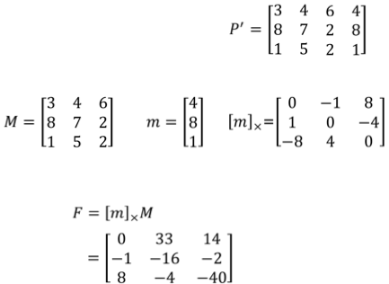

Mathematical Relations for Epipolar Geometry
Fundamental Matrix
Fundamental and Essential Matrices
Exercise -1
Solution

Slide 4
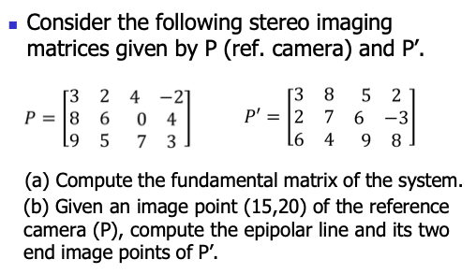
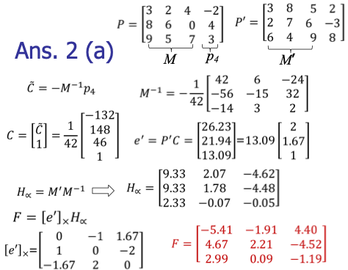
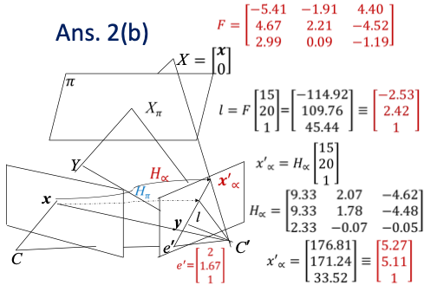
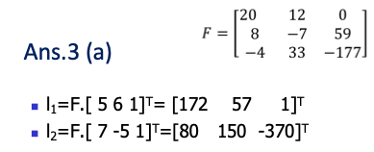
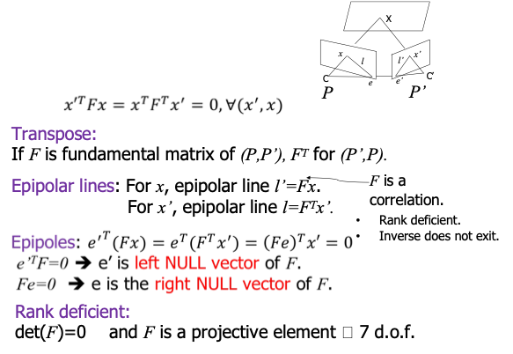
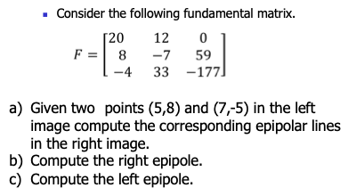
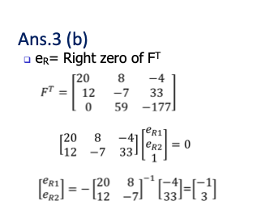
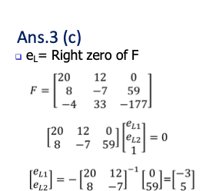
Exercise -2
Solution
Fundamental Matrix: Properties
Solution
Exercise -3

Slide 5
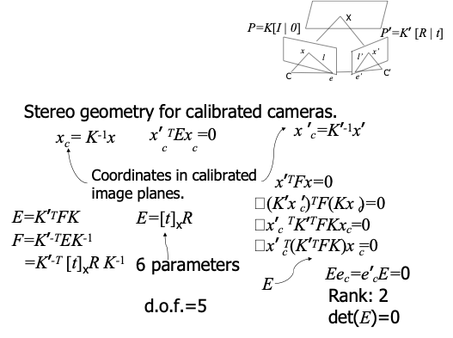
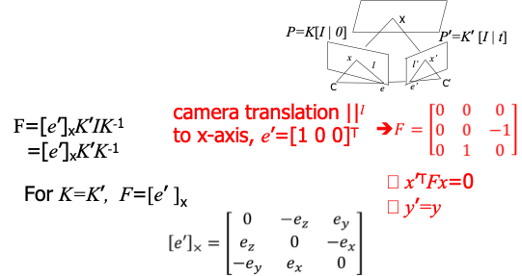
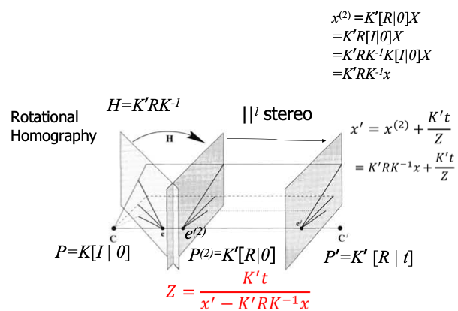
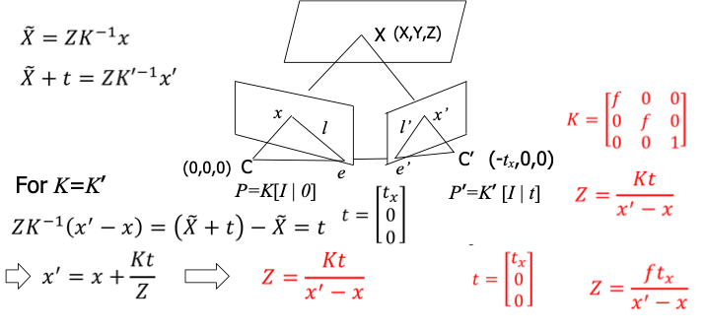
Essential Matrix: Properties
Pure translation
Computing Depth
Pure Translation
General Motion of Camera

Slide 6
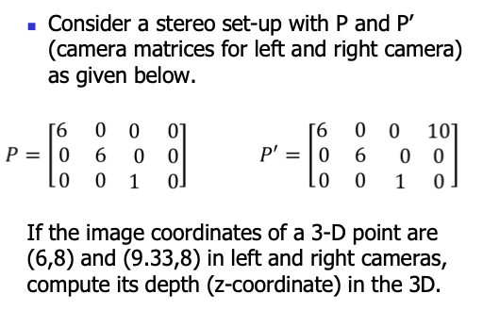
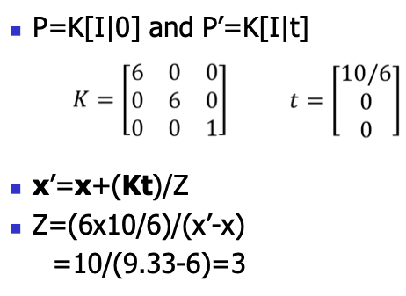
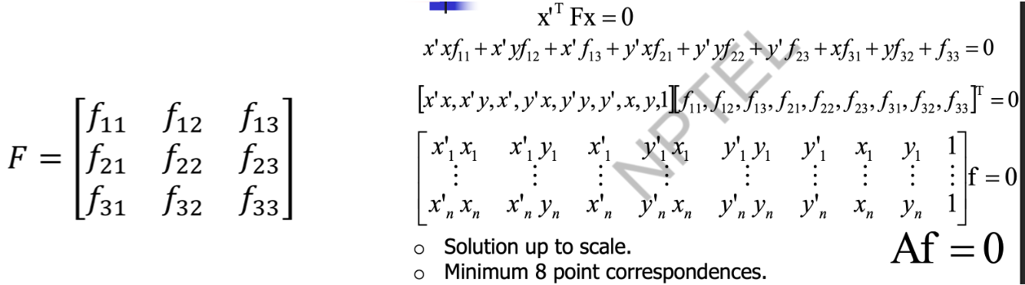
Exercise - 4
Solution
Estimation of Fundamental Matrix

Slide 7
Topics on which Week 4 Assignment Questions are based
Stereo geometry
Epipolar geometry
Fundamental and Essential Matrix
Properties of Fundamental and Essential Matrix
Computing Depth
Estimation of Fundamental Matrix

Slide 8
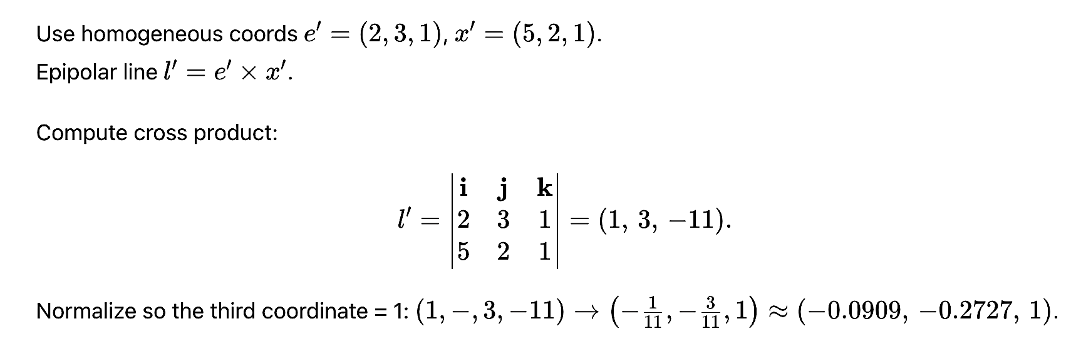
QUESTION 1
Given the right epipole e′ (2, 3) and a point x′ (5, 2) in right image plane of a stereo imaging set up, compute the epipolar line l′ containing the point x′, in right image plane in homogeneous coordinate system.
a) (0.0909, −0.2727, 1)
b) (0.0909, 0.2727, 1)
c) (−0.0909, 0.2727, −1)
d) (−0.0909, −0.2727, 1)
SOLUTION 1
Epipolar line l′ = e′ × x′ in homogeneous coordinate system.
CORRECT ANSWER 1
d)

Slide 9
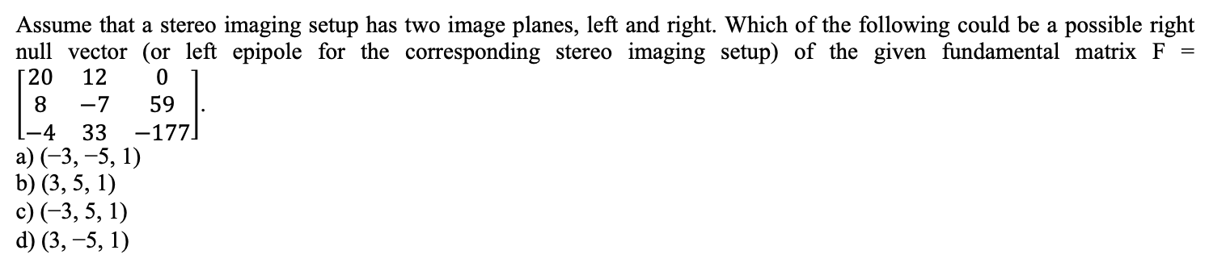
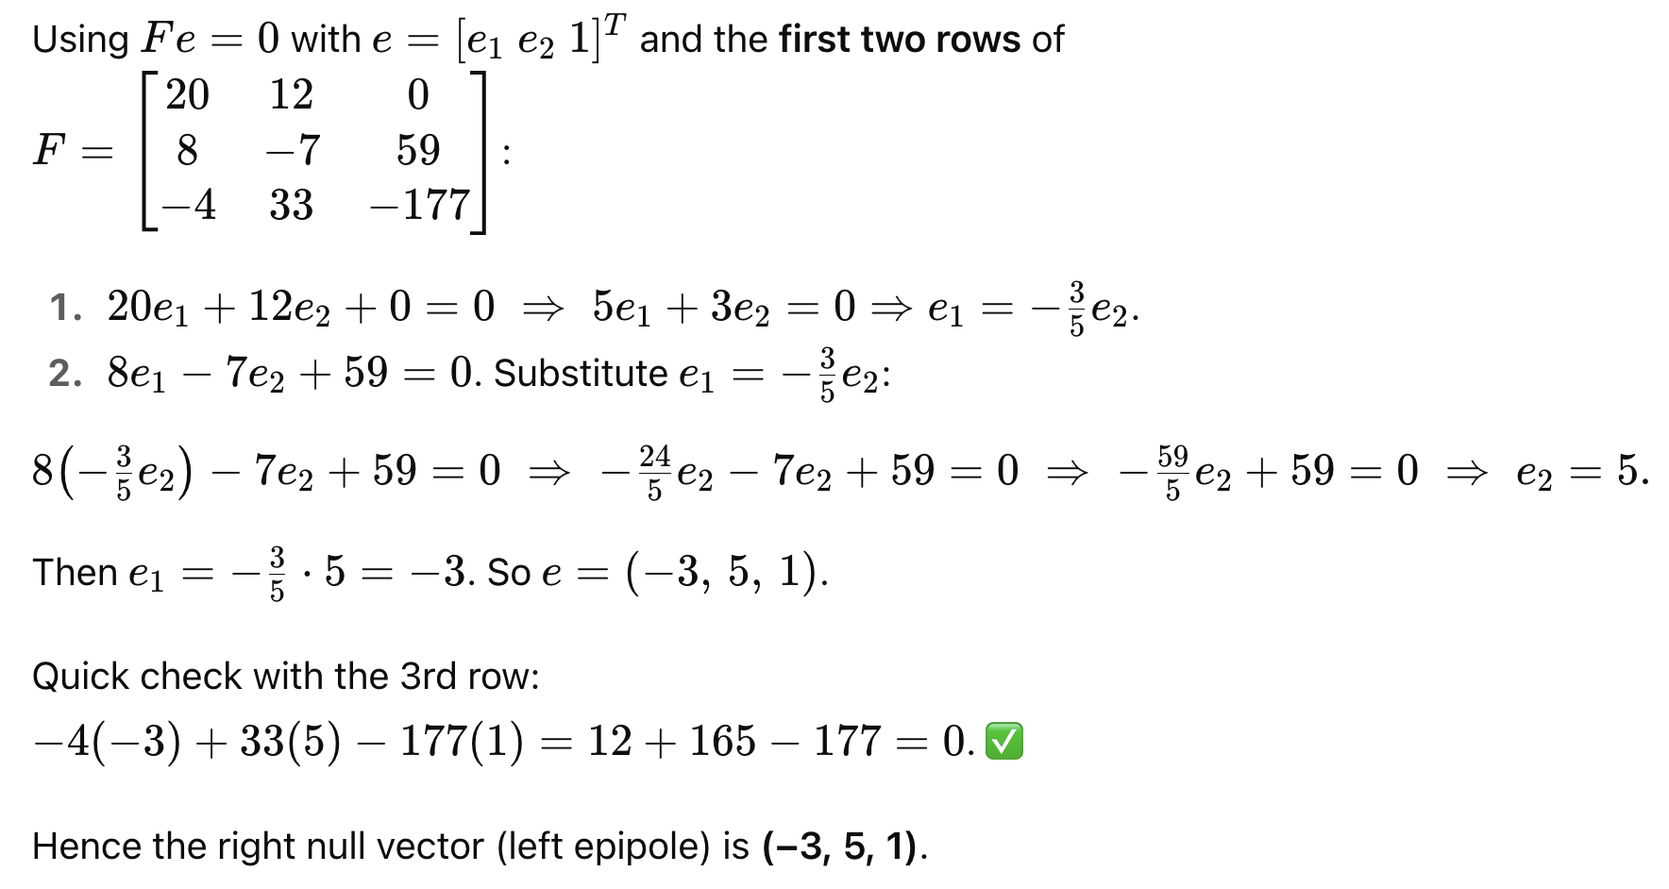
QUESTION 2
SOLUTION 2
Check for Fe = 0, where e is the left epipole or right null vector of F.
CORRECT ANSWER 2
c)

Slide 10
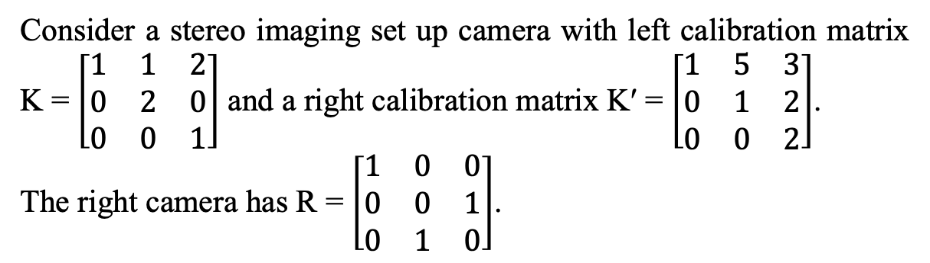
Based on the given parameters, solve the following question 3, 4 and 5.

Slide 11
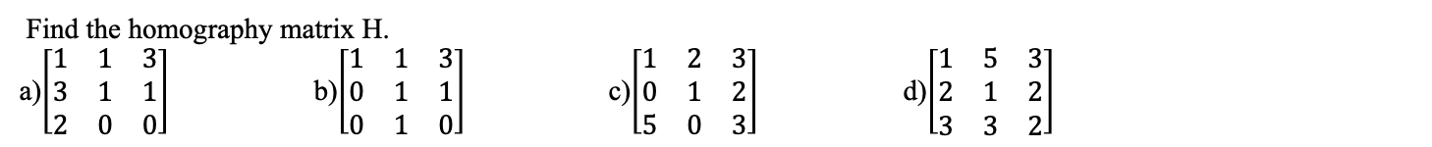
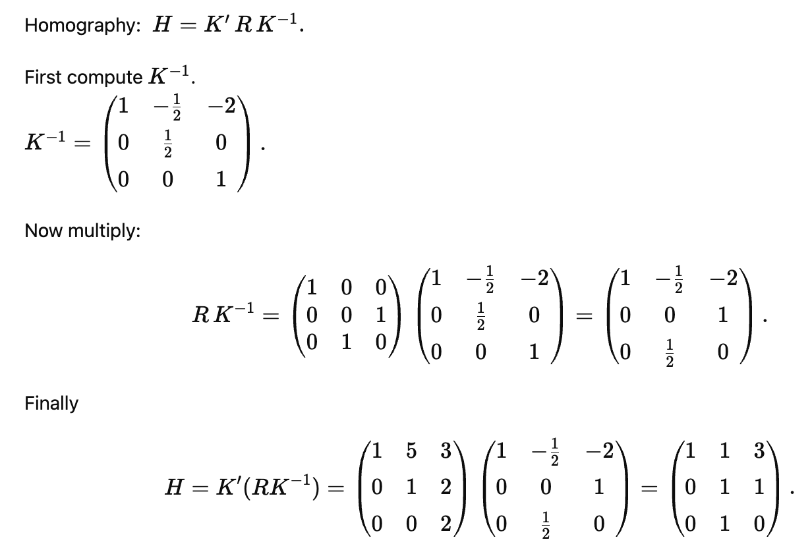
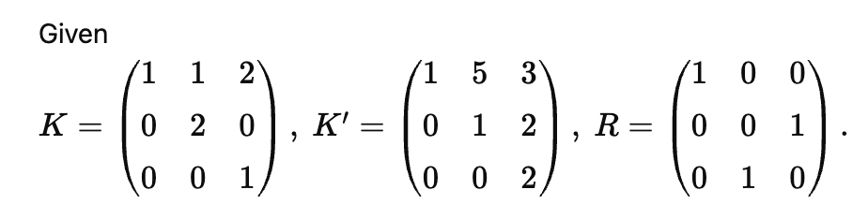
QUESTION 3
SOLUTION 3
CORRECT ANSWER 3
b)

Slide 12
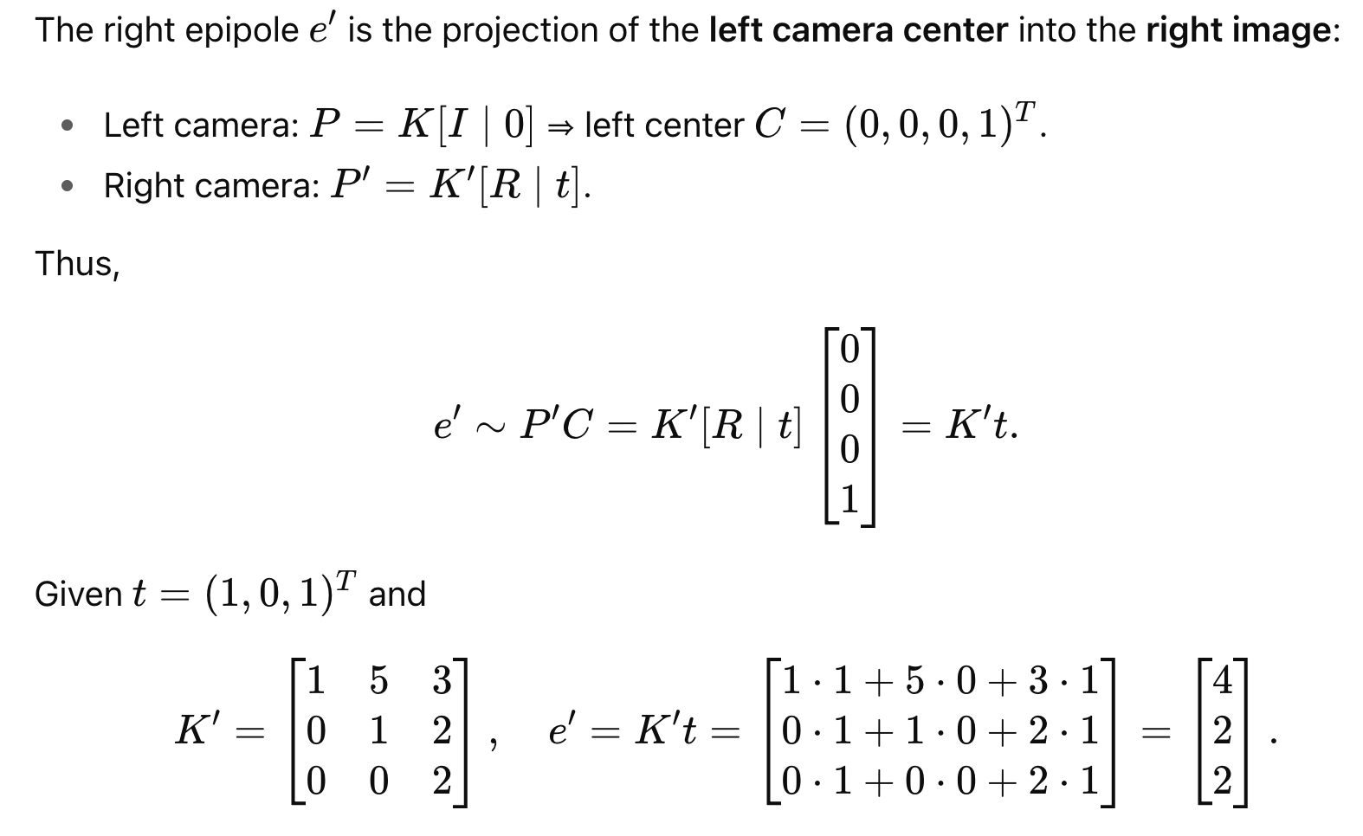
QUESTION 4
Given translation vector t as (1, 0, 1), compute the right epipole.
a) (4, 2, 2)
b) (2, 2, 2)
c) (4, 3, 2)
d) (4, 2, 1)
SOLUTION 4
CORRECT ANSWER 4
a)

Slide 13
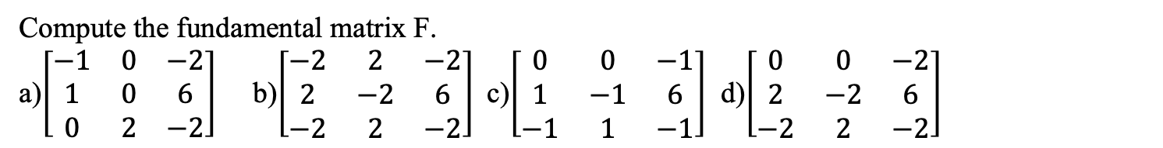

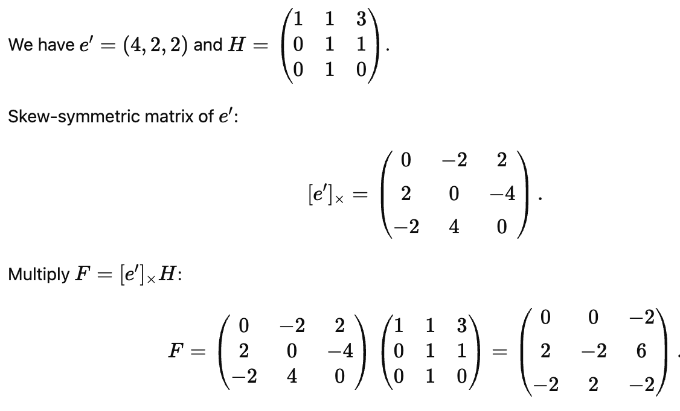
QUESTION 5
SOLUTION 5
CORRECT ANSWER 5
d)

Slide 14
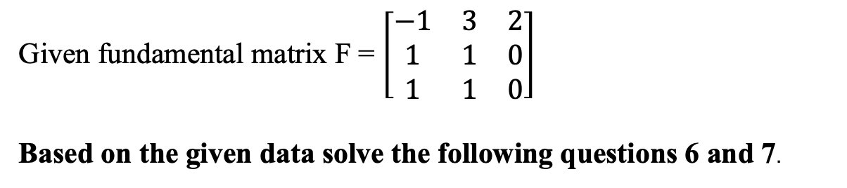

Slide 15
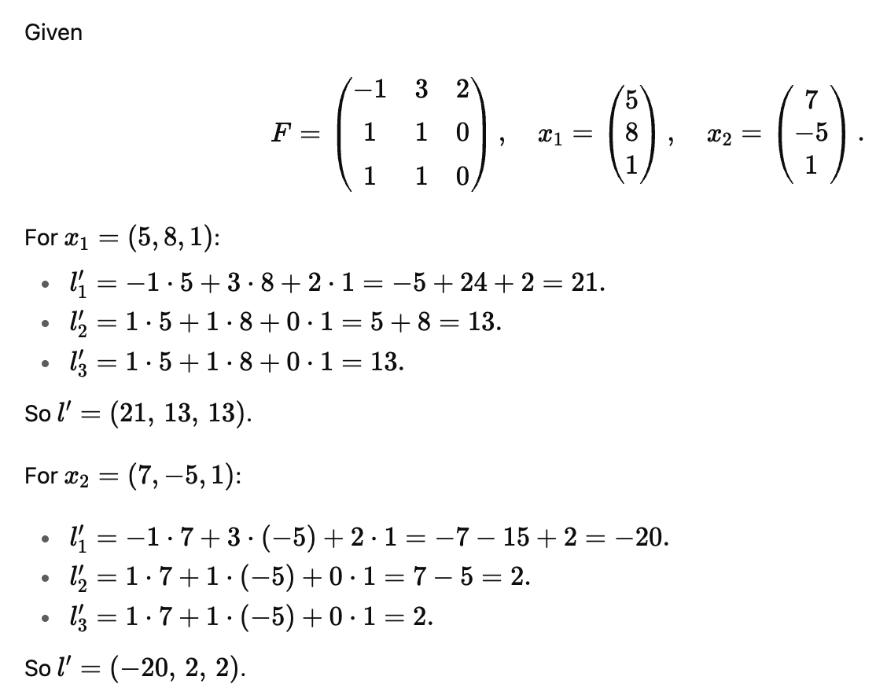
QUESTION 6
Given two points (5, 8) and (7, −5) in the left image. Compute the epipolar lines.
a) (−21, 13, 13), (−20, 2, 2)
b) (21, 13, 13), (−20, 2, 2)
c) (21, 13, 13), (20, 2, 2)
d) (−21, 13, 13), (20, 2, 2)
SOLUTION 6
Epipolar line is given by l′ = Fx.
CORRECT ANSWER 6
b)

Slide 16

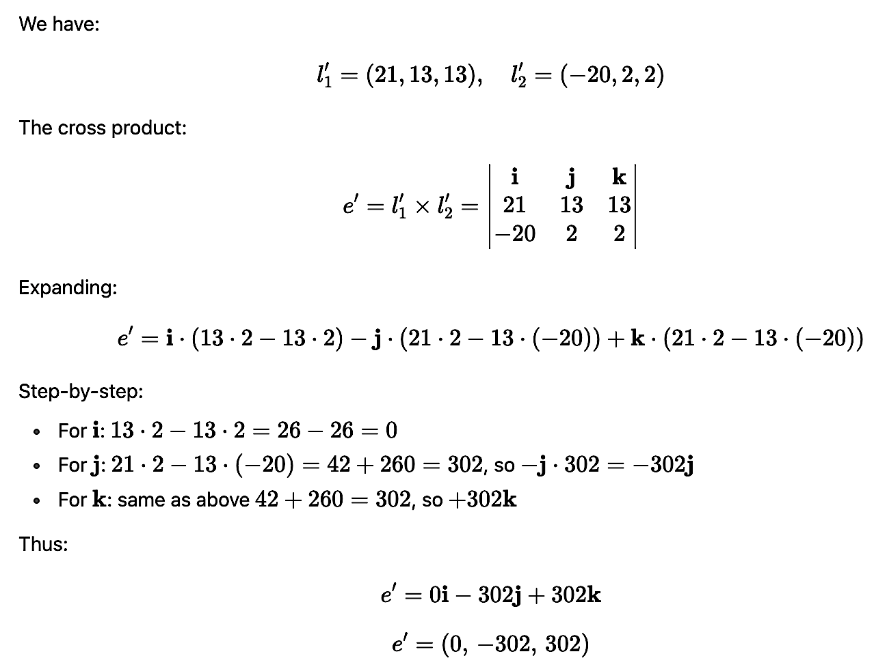
QUESTION 7
Find the right epipole.
a) (0, 302, 302)
b) (0, −302, −302)
c) (0, 302, −302)
d) (0, −302, 302)
SOLUTION 7
CORRECT ANSWER 7
d)

Slide 17
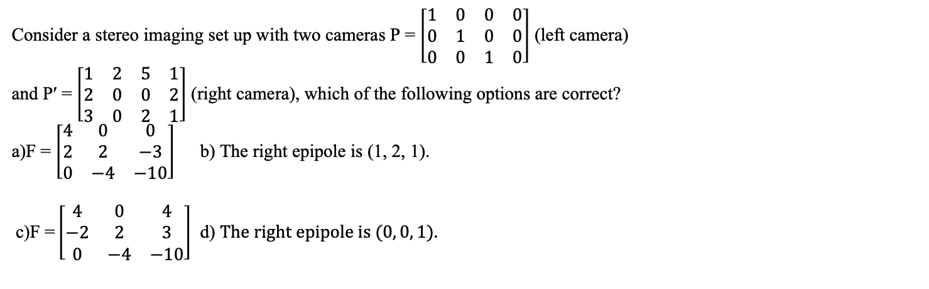
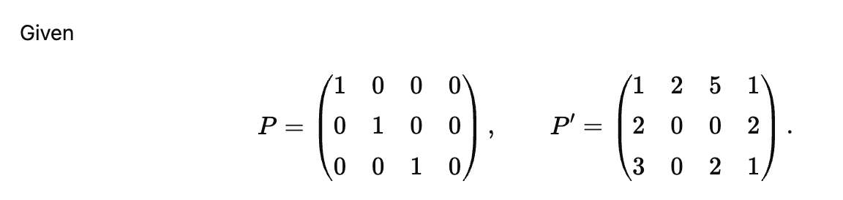
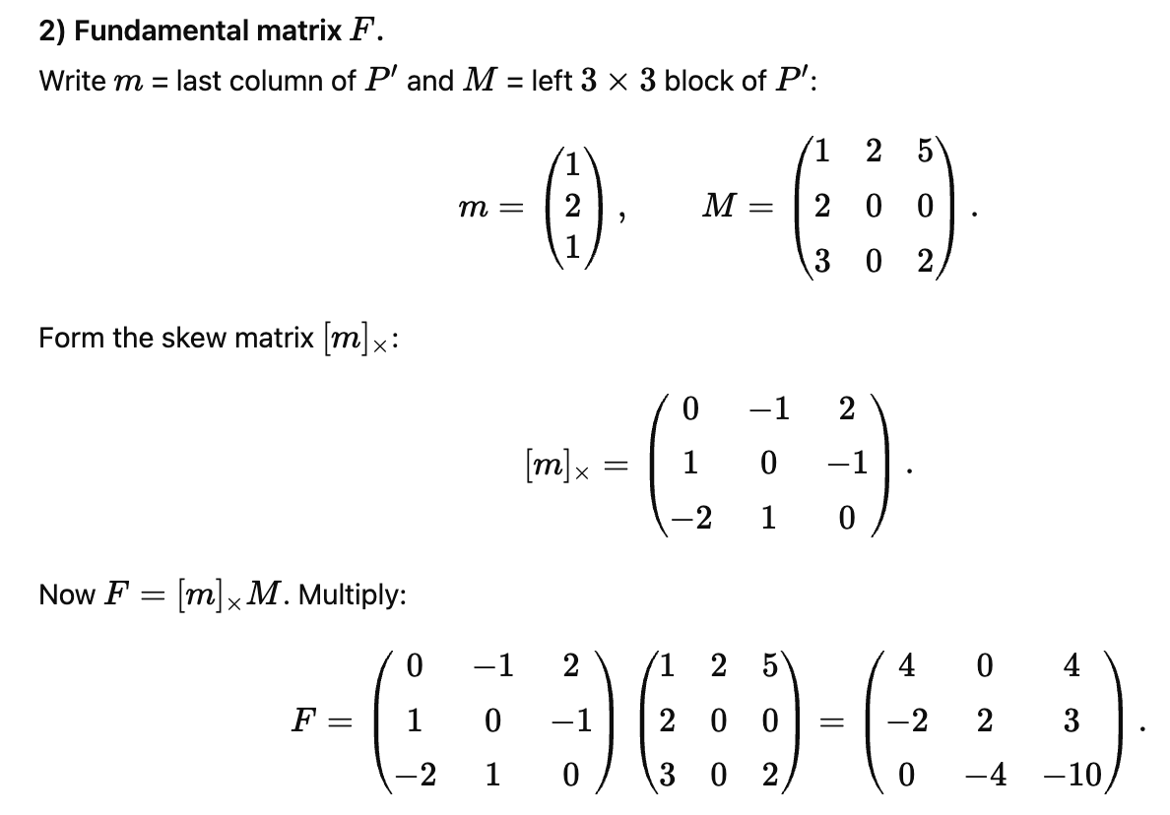
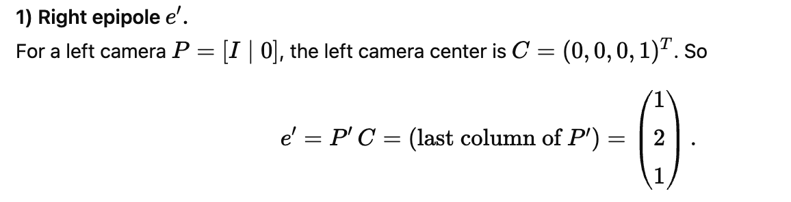
QUESTION 8
SOLUTION 8
CORRECT ANSWER 8
b), c)

Slide 18
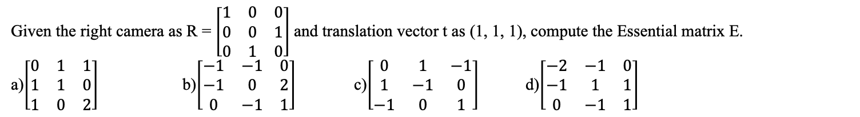

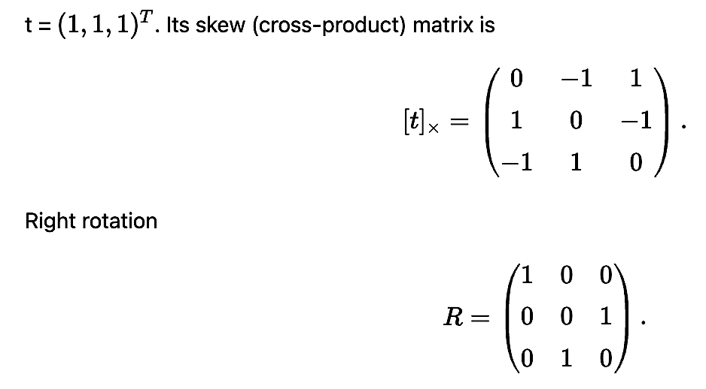
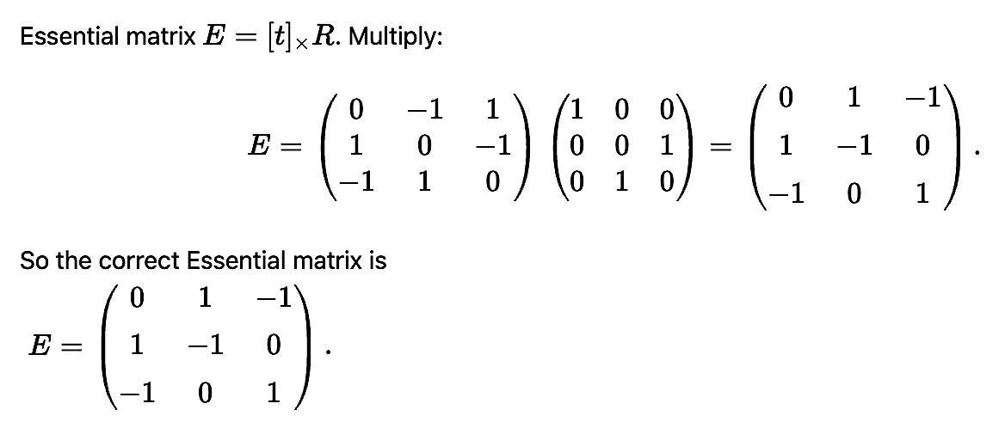
QUESTION 9
SOLUTION 9
CORRECT ANSWER 9
c)

Slide 19
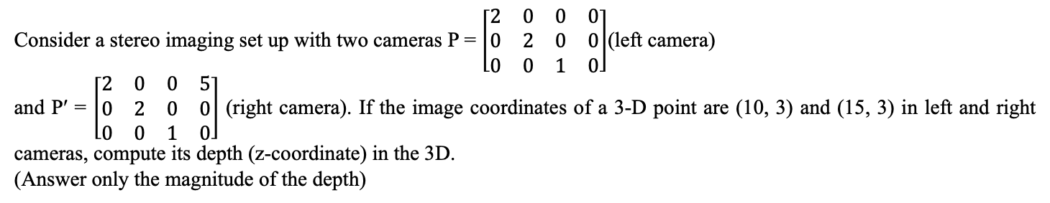
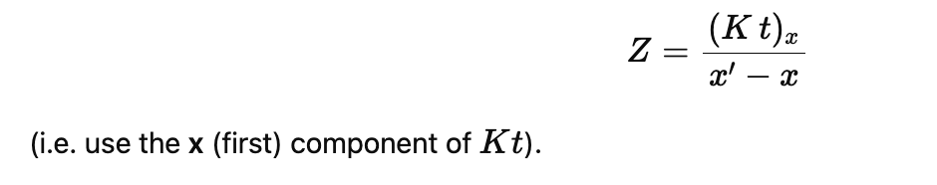
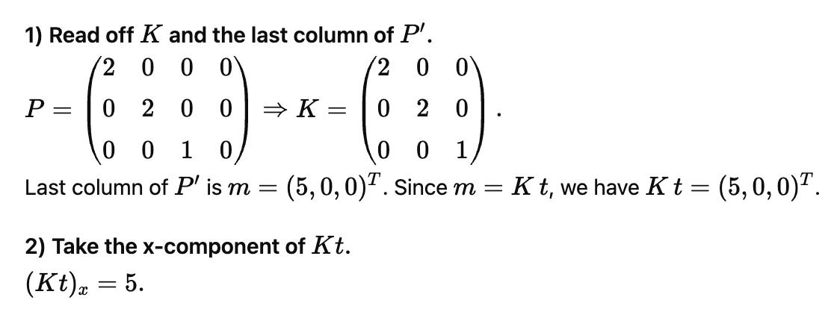
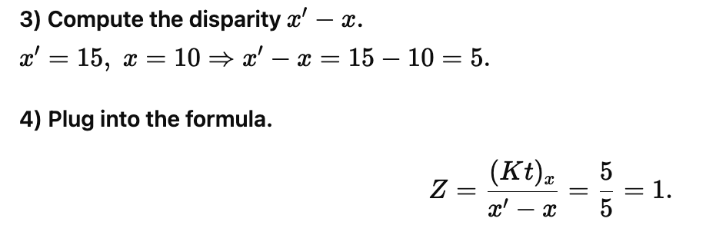
QUESTION 10
SOLUTION 10
CORRECT ANSWER 10
1

